Slide 1

Tian Xia
Nov,11 2011

Slide 2
1. Inter Thread Communication
Because the threads share the same virtual space,
They are easier to communicate with each other.
They can access the resource directly.
But they need to use the synchronization tool to void race condition.
Critical section(kernel object) can be used for them.
Code segment
Data segment
……
A Process
Thread 1
Thread 2
Thread n
…

Slide 3
2. Inter Process Communication
Because each process has their own virtual address space. One process can not access another process address space. So it’s no way to access the source of the other process
If they want to communicate, they must use some mechanisms the OS provides.
Process 1
Process 2
Process n
Resource
Resource
…
Resource
A
System

Slide 4
Mechanism:
PIPE
SHARED MEMORY
SOCKET
MESSAGE
SHARED SECTION
…

Slide 5
2.1 Pipe
First type : Anonymous
    Unnamed
    Local
    One way
    Relationship
Usage:
Typically redirecting the standard input or output of a child so that it can exchange data with its parent process.
Local System
Process A
“ABC”
in
out
Process B
“ABC”

Slide 6
Sample: 01AnonymousPipeParent/01AnonymousPipeChild
  file data -> parent process
  -> child process
  -> parent process
Parent Process
01PipeA.log
stdout
No.1
No.4
No.2
Pipe2
Pipe1
Child Process
stdout
No.3
stdin

Slide 7
Second type : Named
    Named
    Network
    One way
    /Duplex
    Different buff
    /Handle
    IP in the pipe name
Sample: 01NamedPipeServer/01NamedPipeClient
Network
System A
Process A
“ABC”
System B
Process B
“ABC”

Slide 8
Convenient
Safe
Size can be set
Not efficient compared with the shared memory
Method:
1. Anonymous:
CreatePipe();
2. Named:
  CreateNamedPipe();
  ConnectNamedPipe();
  3. Common:
  ReadFile();
  WriteFile();
  CloseHandle();

Slide 9
2.2 Shared Memory
Manipulate the memory directory
Local
Process A
address
“ABC”
Process B
address

Slide 10
Relationship between the view and the physical object
Process A
File View
Physical
Memory
File
on disc
File
Mapping
Object
Process B
File View

Slide 11
efficient (space/time)
Size large
Method:
CreateFileMapping();
MapViewOfFile();
UnmapViewOfFile();
CloseHandle();
Sample: 02SharedMemoryA/02SharedMemoryB

Slide 12
2.3 Socket
Network Communication
Server
Client
Create socket
Create socket
Bind ip/port
Connect ip/port
listen
send
accept
recv
recv
closesock
send
closesock

Slide 13
IO Complete Port
Usage:
1. Associate a File(overlapped) to Port.
2. If there is an operation about the file,
3. The port will trigger the thread to process the operation.
Method:
CreateIoCompletionPort();
GetQueuedCompletionStatus();
PostQueuedCompletionStatus();
CloseHandle();

Slide 14
Socket and IO Complete Port
Efficient(Less thread switch)
Flexible

Slide 15
Sample: 03SocketServer/03SocketClient
…
I/O complete
port
Server
S1
S1
I/O Complete Packet
queue
Thread 1
Complete Packet 1
File 1
Client 1
S2
Thread 2
Complete Packet 2
File 2
Client 2
…
S3
…
…
…
Get
Recv/Send

Slide 16
2.4 Message
Inter thread(Send/Post)
Inter Process(Send)
Sample: 04Message
Process
PostMessage
SendMessage
Thread 1
Thread 2
Data
Process1
SendMessage
WM_COPYDATA
Process2
Data
Data

Slide 17
2.5 Shared Section
For the same executable file(same path).
Each process has the same address
Format:
    #pragma data_seg("Shared")
    Data define
    #pragma data_seg()
    #pragma comment(linker, "/Section:Shared,RWS")
Sample: 05SharedSection
Process
Data segment
Shared segment
…

Slide 18
3. Synchronization
Procsss：
  WaitForSingleObject
  WaitForMultipleObject
  Event
  Mutex
  Semaphore
  ……
Thread only：
  Critical Section (not kernel object)

Slide 19
3. 1 Mutex
Feature
  More flexible
  Less speed/100 times lower than critical section
  Signed status if it is not used
  Can be not signed if a thread exit
  Wait abandoned(Wait_ABANDONED_0_X)
  Only the mutex has this feature
  Only can be release by the owner thread.
Method：
  CreateMutex();
  OpenMutex();d
  ReleaseMutex();
  CloseHandle();
  WaitFor… ();
Sample：
  07Mutex

Slide 20
3. 2 Semaphore
Feature
  Define a resource number( =1 Mutex).
  Can be release by any thread.
Method：
  CreateSemaphore();
  OpenSemaphore();
  ReleaseSemaphore() ;
  CloseHandle() ;
  WaitFor… ();
Sample：
  08Semaphore

Slide 21
3. 3 Event
Feature
  Can not be affected by the WaitFor… call.
  Free to control
  Maybe lost for the auto-reset type
  It is also be used in the file operation(Read/Write)
Method：
  CreateEvent();
  OpenEvent();
  ResetEvent();
  SetEvent();
  PulseEvent();
  CloseHandle();
  WaitFor… ();
Sample：
  06Event

Slide 22
3. 4 Critical Section
Feature
  Not kernel object
  Fast(no switch between user status and kernel status )
  Not know if the thread is alive
Method：
  InitializeCriticalSection();
  EnterCriticalSection();
  LeaveCriticalSection();
  DeleteCriticalSection();

Slide 23
Reference
1. Inter Process Communications
http://msdn.microsoft.com/en-us/library/windows/desktop/aa365574(v=VS.85).aspx
2. Using the synchronization
http://msdn.microsoft.com/en-us/library/windows/desktop/ms686967(v=vs.85).aspx
3. Win32多线程程序设计.pdf
by Jim Beveridge/Robert Wiener
4. Windows 核心编程
by Jeffrey Richter

Slide 24
Q/A
HP Confidential

Slide 25
No1：Pipe size
Q：Why is the program dead when the data size is about 9K, ?
A：Because when the pipe is created, the pipe
size doesn’t be set. It used the system default value.
By setting the appropriate pipe size to nSize, the problem can be fixed.
BOOL WINAPI CreatePipe(
__out PHANDLE hReadPipe,
__out PHANDLE hWritePipe, __in_opt LPSECURITY_ATTRIBUTES lpPipeAttributes, __in DWORD nSize );

Slide 26
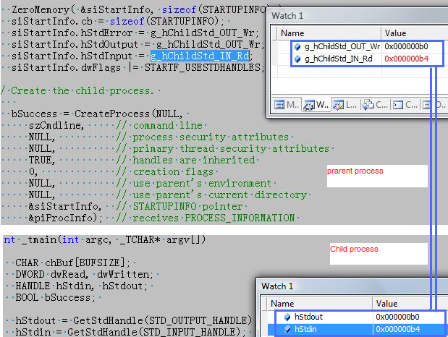
No2：Child process handle
Q：why the child process can use the handle
value of the parent process handle as below:
(Parent handle value = child handle ) ?

Slide 27
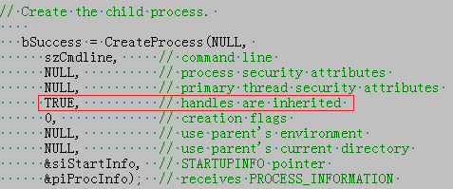
A： Because If the TRUE is set to CreateProcess' bInheritHandles parameter, the system copies the entry exactly into the child process' handle table. The entry is copied to the exact same position in the child process' handle table as in the parent's handle table. This fact is important because it means that the handle value that identifies a kernel object is identical in both the parent and child processes.
HP Confidential

Slide 28
No3：SendMessage
Q：How does the SendMessage work?
A：
case1. If the specified window was created by the calling thread, the window procedure is called immediately as a subroutine.
Case 2. If the specified window was created by a different thread, the system switches to that thread and calls the appropriate window procedure. Messages sent between threads are processed only when the receiving thread executes message retrieval code. The sending thread is blocked until the receiving thread processes the message. However, the sending thread will process incoming nonqueued messages while waiting for its message to be processed.

Slide 29
This is a sample description about sending a message to another thread.(Case 2)
Sample: App1 sends a user message to App3.
Sending Flow(please refer to the next page):
App1 SendMessage ---> App3 Windows procedure.
If posting, Flow is:
App1 PostMessage ---> App3 Thread queue ---> App3 Windows procedure.
Note:
As for how the App3 Windows procedure is switched
by the system. Sorry I don’t clear even I investigated
some internet information.
Only the below informaiton is known:
The App1 calls the SendMessage,
The SendMessage is a system call by a interrupt
which switch the user status to the system’s kernel status.
How the App3 Windows procedure run depends on the system completely. It’s difficult to the system process.

Slide 30
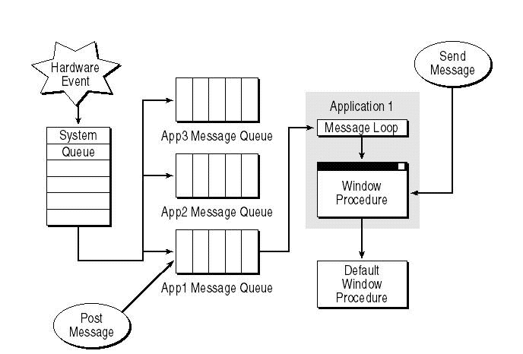

Slide 31
END
HP Confidential

